Slide 1
Photochemistry of 2-Hydroxyazobenzene
Ubaidullah S. Hassan, Arshad Mehmood, and Benjamin G. Levine

Slide 2
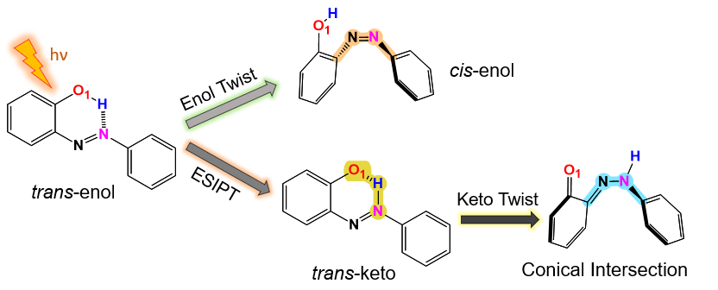
2-Hydroxyazobenzene Undergoes Competing Photoisomerization and Excited State Intramolecular Proton Transfer (ESIPT)
Notes:
-2HA can undergo both photoisomerization and ESIPT, with both of these mechanisms giving potential for applications with photocontrolled materials
-Here is the molecule in its most stable ground state form, trans-enol. There are two benzene rings that are planar and connected with two nitrogens. And then there is an ortho substituted O-H group on one of the rings.
-When the molecule absorbs light it can be photoexcited to the second excited state S2, then in the dark S1 state it can either undergo isomerization, so twisiting into the cis-enol form, or proton transfer into the keto form which is then followed by twisiting
-Some previous work has been done on this moluelce using static multi-reference methods, but we want to further map out the potential energy surface using since theres a variety of paths this molecule can take when non-radiatvly relaxing down to the ground state from the second excited state. There is a lack of research on the dynamics of the molecule us ab initio methods, which we aim to address with the TAB code

Slide 3
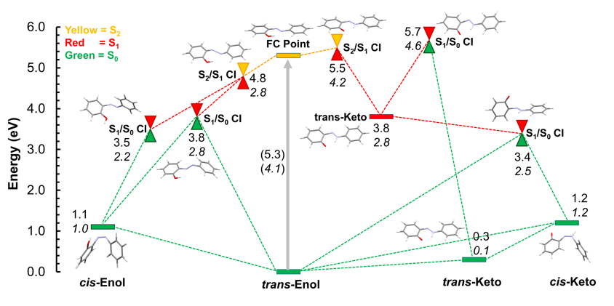
Mapping out the potential energy surfaces with static calculations
FOMO(0.15)-CAS(10,7)CI
XMS-CAS(10,7)PT2
Notes:
-Here is the plot of optimized FOMO-CASCI energies with CASPT2 energies written in italic below. The lines represent minima and the cones represent conical intersections between the three states. The ground state is shown in green, the S1 state is shown in red and the S2 state is yellow.
-Starting at the ground state trans-enol geometry, the molecule is photoexcited to the Frank-condon point on the S2 state and then it has options for how it relaxes down. We found two main pathways: an Enol twisiting path to the left and a proton transfer path to the right.
-So going to the left from this conical intersection the molecule then has two options for twisiting in the enol form to a conical intersection
-going to the right the molecule can undergo proton transfer to get near this trans-keto minima in the S1 state and then again there are two options for conical intersections, but we see that this keto twisting conical intersection is much more energically favoiable.
-since FOMO-CASCI is the electrnic structure method that we use for our dynamics simulations, its important to establish its limitations by looking at barriers for some of these processes

Slide 4
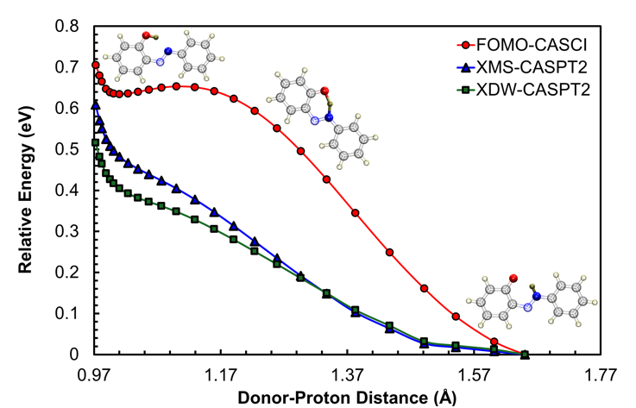
Linearly Interpolated Internal Coordinate (LIIC) Path for Proton Transfer on S₁ State
Notes:
-Here is the Linearly Interpolated Internal Coordinate path for proton transfer on the S1 state, so we give it the starting trans-enol geometry and the ending trans-keto minima on the S1 state and it searches for the minimum energy path between the two.
-The optimizations at each point are done with FOMO-CASCI and single point CASPT2 calculations are done on those geometries.
-We see that the FOMO-CASCI slightly overestimates the barrier when compared to CASPT2
-but overall the process is barrierless, so we would expect this to happen relatively fast on the S1 state

Slide 5
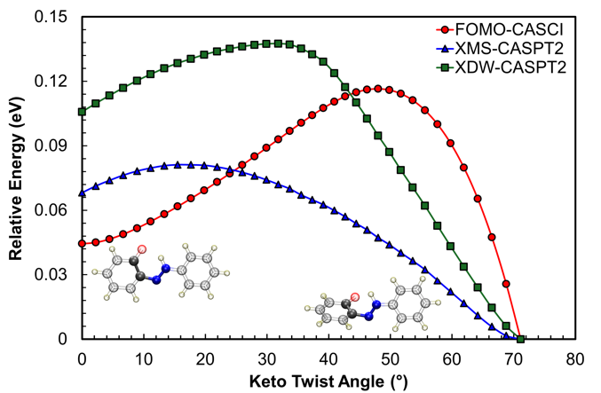
LIIC Path for Keto Twisting on S₁ State
Notes:
-Now here is the Path for twisting from the Trans-Keto minima to the conical intersection on the S1 state, so after proton trasnfer
-This time there is an energy barrier that needs to be overcome
-again FOMO-CASCI overestimates this barrier, which means our dynamics simulations might overestimate the time trajectories on these paths spend on the S1 state
-so we’ve studied what the different paths look like but to actually study the ratios of branching into these paths we turn to our dynamics simulations

Slide 6
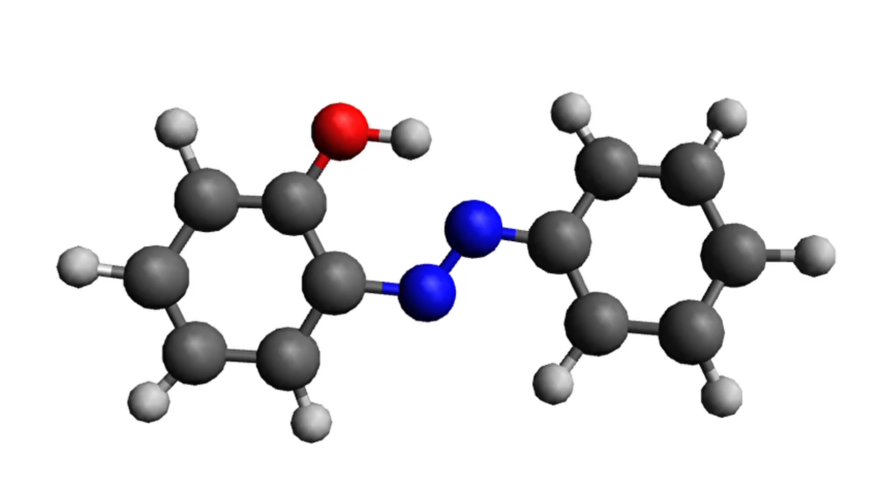
Non-adiabatic Molecular Dynamics using TAB
Notes:
-so heres an example of one of our trajectories using TAB
-the molecule starts on the S2 state and quickly relaxes down to S1 from some vibrations.
-then proton transfer occurs quickly on the S1 state since we saw it was a barrierless process
-now we see that the twisting takes a lot more time since we saw a barrier for that process

Slide 7
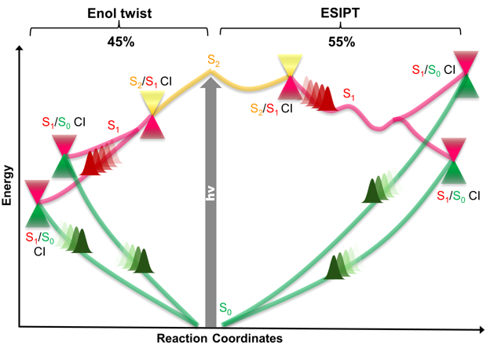
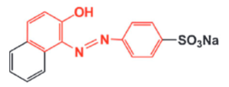
9 Simulations with different Initial Conditions
Average lifetime on S₂ was 5 fs
Average time to proton transfer was 40 fs
≈ 30 fs
A. Douhal, M. Sanz, L. Tormo, Proc. Natl. Acad. Sci. USA 2005.
Average time to S₀ was 322 fs for proton transfer paths and 231 fs for enol twisting paths
Notes:
-we ran 9 different initial conditions and saw that 5 tejectories went on the proton transfer path and 4 went to the enol twisting path
-the average lifetime on S2 was 5 fs so pretty much noting interesting happens on S2 like we saw
-for the proton transfer paths we saw an everage tome of 322 fs to get to the ground state and 231 fs for the enol twisiting path. This is likely due to the barrier that is involved with the keto-twisiting at the end of the proton transfer path

Slide 8
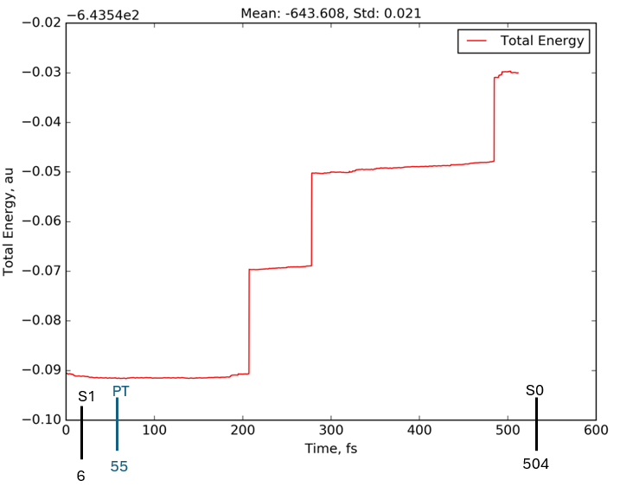
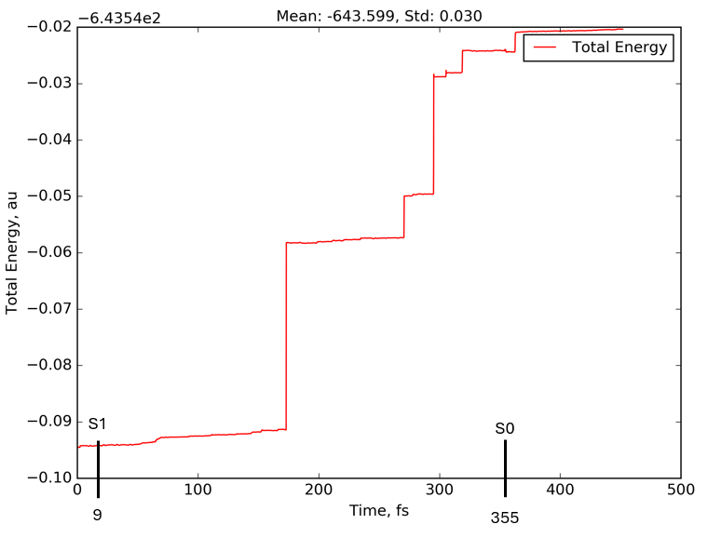
Problem: Energy is not conserved
Notes:
-so the main problem is that for our TAB simulations the energy is not being conserved well.
-we see energy changes of around .1 hartees while what we should be aiming for is .01 hartees
-a lot of effort this summer has been hoping to find a better active space which didn’t go well, one thing we might try is using AIMS

Slide 9
Acknowledgments
Seawulf and SDSC Expanse HPC clusters for computation facility (CHE140101)
This research was supported by the Data + Computing = Discovery! REU site,
which is sponsored by the NSF under grant 1950052.

Slide 10
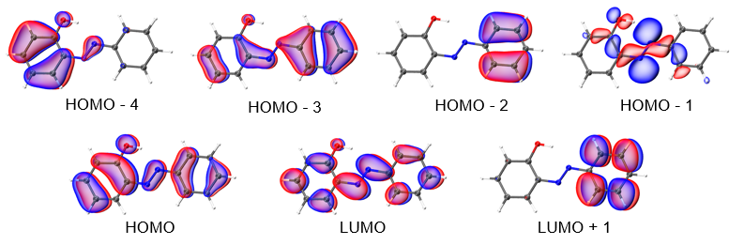

Slide 11
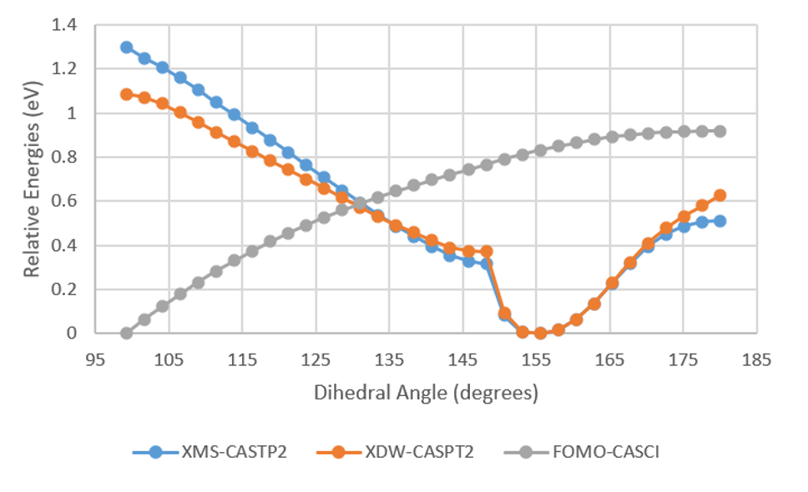
Relaxed Scan for Enol Twisting

Slide 12
